Slide 1


3
Methods and Behaviors
C# Programming: From Problem Analysis to Program Design
3rd Edition

Slide 2
Chapter Outline
Method Definition
static Modifier
Class Methods
Access Modifiers
Return Type
Parameters
Overloaded Methods

Slide 3
Chapter Outline
Math Class Methods
User-Defined Methods

Slide 4
1. Method Definition
Method definition contains heading and body
Example: Main( ) method
static void Main()
{
. . .
}
Method
Heading
Method
Definition
Method Body

Slide 5
Method Heading
Method heading contains
modifiers
return type
method name
parameter list (may be empty)

Slide 6
Method Heading
Example: Max( ) method in Math class (in .NET Framework class library)
public static double Max(double n1,
double n2)
Return type
Method name
Modifier
Modifier
Parameter list

Slide 7
Method Signature
Method name and parameter list forms method signature
Example: Max( ) method
. . . Max(double n1, double n2)
Method
Signature

Slide 8
2. static Modifier
Method Main() must include static modifier in the method definition
Methods Write(), WriteLine(), and ReadLine() of the Console class include the static modifier in their method definitions
All methods of Math class also include the static modifier in their method definitions

Slide 9
3. Class Methods
Methods that use the static modifier are called class methods
To invoke/call a class method, use format:
<class-name>.<method-name>
Example: to call WriteLine() method:
Console.WriteLine("The end");
Example: to call Max() method:
double result = Math.Max(2.0, 8.9);

Slide 10
4. Access Modifiers
Another type of modifier is an access modifier
The following are access modifiers:
public
private
Example:
public static double Max(double n1,
double n2)

Slide 11
public Access Modifier
public access modifier in a method definition indicates that the method can be called (accessed) from other methods in any class
Methods Write(), WriteLine(), and ReadLine() of the Console class and all methods of the Math class include public access modifier in their method definitions
These methods can be called from other methods in any class

Slide 12
private Access Modifier
private access modifier for a method indicates that the method can only be called from other methods defined in the same class where the method is defined

Slide 13
5. Return Type
Indicates what type of value is returned when the method is completed
void
No value being returned
return statement required for all non-void methods

Slide 14
Return Statement
Return type
public static double CalculateMilesPerGallon
(double miles, double gallons)
{
return miles / gallons;
}
double type value returned

Slide 15
6. Parameters
Parameters are passed to methods using one of two ways:
Call by value
Call by reference
In call by value, a copy of the original value is passed to the method
In call by reference, the method refers to the same variable that is passed into the method

Slide 16
Parameters – By Value
using System;
class ParameterTest
{
public static void Main()
{
int testValue = 1;
ParameterTest.TestDefault(testValue);
}
public static void TestDefault(int aValue)
{
aValue = 111;
}
}

Slide 17
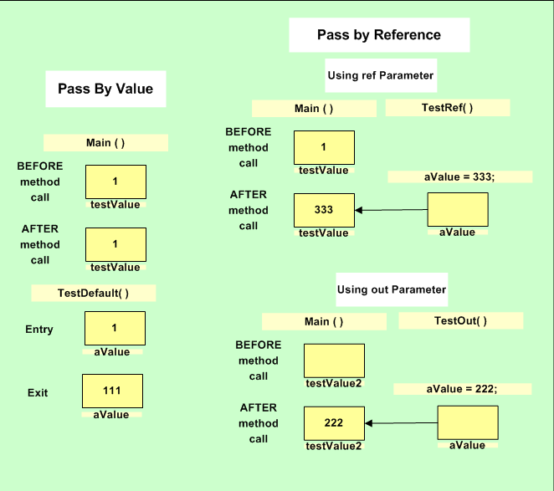
Parameters – By Value

Slide 18
Parameters – By Reference
For call by reference, there are two choices with two different keywords: ref and out
When ref keyword is used, the argument in the calling method must be initialized before the method call; the out keyword does not have this restriction
out keyword is useful to pass data out of the called method

Slide 19
Parameters – By Reference
using System;
class RefParameterTest
{
public static void Main()
{
int testValue = 1;
RefParameterTest.TestRef(ref testValue);
}
public static void TestRef(ref int aValue)
{
aValue = 333;
}
}

Slide 20
Parameters – By Reference

Slide 21
Parameters – By Reference
using System;
class OutParameterTest
{
public static void Main()
{
int testValue;
OutParameterTest.TestOut(out testValue);
}
public static void TestOut(out int aValue)
{
aValue = 222;
}
}

Slide 22
Parameters – By Reference

Slide 23
Method Call
Note that since the method TestOut( ) is in the same class as the Main( ), the class name in the method call is optional
That is, instead of:
OutParameterTest.TestOut(out testValue);
We can simply write:
TestOut(out testValue);

Slide 24
7. Overloaded Methods
The Write( ) and WriteLine( ) methods are overloaded methods
Overloaded methods means that there are multiple methods with the same name but each has a different number or type of parameter
Example of 2 Write( ) methods with headings:
public static void Write(int number)
public static void Write(double number)

Slide 25
Overloaded Methods
.NET includes 18 different Write( ) methods with different signatures
How does the Common Language Runtime (CLR) know which method to use when the Write( ) method is called?
Example:
Console.Write(45);
Console.Write(67.34);
int type argument
double type argument

Slide 26
Overloaded Methods
When the Write( ) method is called, the argument used in the method call is matched with the method signatures to determine which method to execute
Note also that there are 19 overloaded WriteLine( ) methods

Slide 27
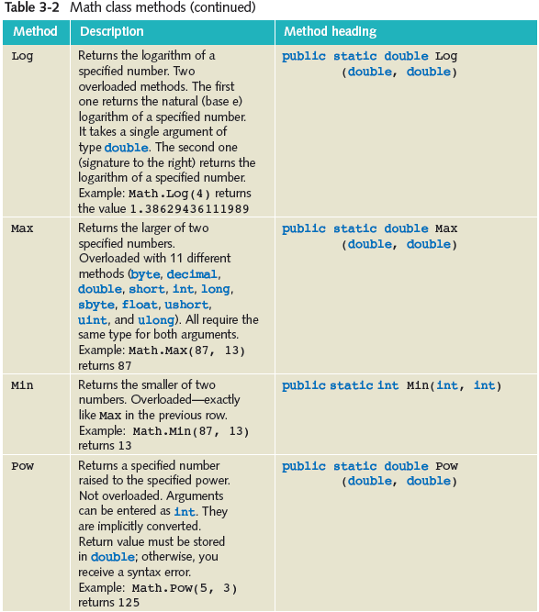

8. Math Class Methods

Slide 28
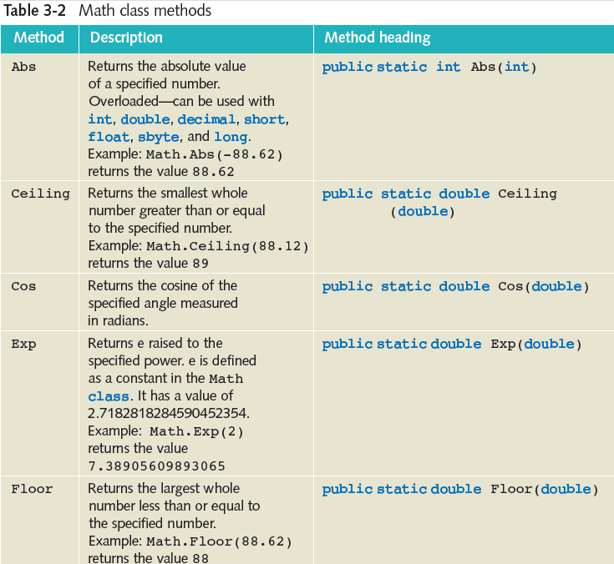

Slide 30
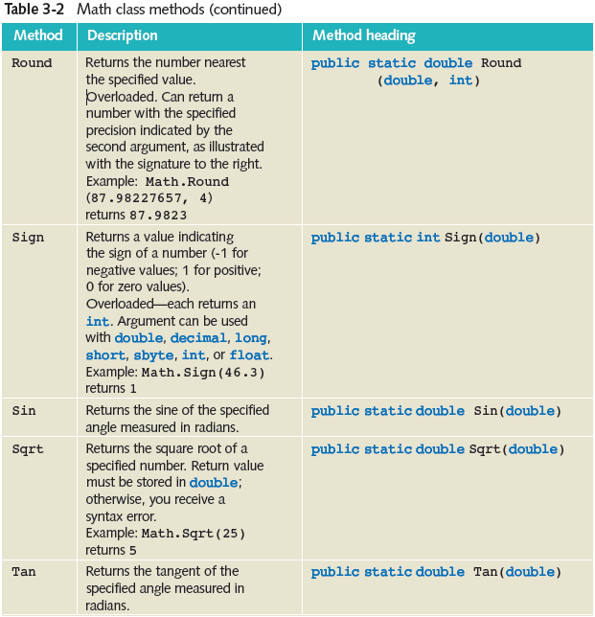

Slide 32
Type Coercions
To force conversion from one primitive type to another, we use casting
This is explicit type coercion
Implicit type coercion automatically converts from a smaller data type to larger e.g. from int to long, float, double, or decimal
Example: Math class method Sqrt( ) requires an argument of type double

Slide 33
Implicit Type Coercion
If the argument value is type int, the CLR automatically converts it to type double and passes to the method
Example:
double root = Math.Sqrt(25);

Slide 34
9. User-Defined Methods
Suppose we want to develop a payroll program which inputs the hours worked and the pay rate for an employee and then computes and displays the pay.
If we do not apply the object-oriented approach, we can define 4 static methods to do the work:
Main( ), GetPayData( ), ComputePay(), and PrintPay()

Slide 35
User-Defined Methods
using System;
class PayrollProgram
{
public static void Main( )
{ . . . }
public static void GetPayData( . . . )
{ . . . }
public static decimal ComputePay( . . . )
{ . . . }
public static void PrintPay( . . . )
{ . . . }
}

Slide 36
Payroll Program
using System;
class PayrollProgram
{
static void Main( )
{
string name;
float hoursWorked;
decimal payRate, pay;

Slide 37
Payroll Program
GetPayData(out name,
out hoursWorked,
out payRate);
pay = ComputePay(hoursWorked,
payRate);
PrintPay(name, pay);
}

Slide 38
Payroll Program
public static void GetPayData(
out string name,
out float hours,
out decimal rate)
{
string input;
Console.Write("Enter name: ");
name = Console.ReadLine();

Slide 39
Payroll Program
Console.Write("Enter hours worked: ");
input = Console.ReadLine();
hours = (float)Convert.ToDouble(input);
Console.Write("Enter pay rate: ");
input = Console.ReadLine();
rate = Convert.ToDecimal(input);
}

Slide 40
Payroll Program
public static decimal ComputePay(
float hours,
decimal payPerHour)
{
return (decimal)hours * payPerHour;
}

Slide 41
Payroll Program
public static void PrintPay(string name,
decimal pay)
{
Console.WriteLine("Pay for {0} "
+ "is {1:c}",
name, pay);
}
} // End of class

